Slide 1
Lab 3
FPGAs as Accelerators
Embedded Systems ECE340
Ioannis Athanasiadis-03491
Stavros Stathoudakis-03512

Slide 2
Introduction
Goal: Implementation of LSAL Algorithm as FPGA Accelerator
Tools:
Valgrind (Code Profiling)
Intel Advisor (Code Profiling)
Vitis HLS
Visual Studio Code
✨FanTAsY ✨

Slide 3
A Few Things About LSAL
Stands for Local Sequence Alignment Algorithm
Used in Bioinfomatics (More on that later)
Input:
Database[M] string
Query[N] string
Output:
Direction Matrix [M*N]
Similarity Matrix [M*N]
Max Index

Slide 4
Submitted Files
FPGA folder contains the source code files need to run the accelerator
Software folder contains the source code files of the optimized
Makefile with options on cpu arch, debug flag and code profiling automation
The submitted files follow the following format.
├── FPGA
│ ├── lsal.cpp
│ └── lsal_host.cpp
├── Software
│ ├── lsal_optimized.cpp
│ └── Makefile
└── Report.pdf

Slide 5
Software
Workflow
Implementation
Profiling
Code Optimization
Comparison
Debug flag
Prints the output of LSAL
Known Input -> Known Outputs
Profiling Flag
Executes valgrind’s callgrind tool
Auto-opens kcachegrind to visualize data

Slide 6
Software Unoptimized
Calculation of Similarity and Direction Matrices Row-Wise
Save the location of element with max similarity
Direction Priority: C, NW, N, W
Edge cases:
First row and first column (N & NW, W & NW)
Loop Unrolling

Slide 7
Software Unoptimized
The results for a varying number of array sizes
x86 78.82% faster than ARM
x86 vs ARM Unoptimized (sec)
Ν | Μ | ARM | x86 | Difference
32 | 32 | 0.000098 | 0.00002 | 79.5918%
32 | 65536 | 0.175177 | 0.037108 | 78.8169%
256 | 65536 | 1.402216 | 0.303335 | 78.3675%
256 | 300000 | 6.417753 | 1.388256 | 78.3685%

Slide 8
Software Optimized
Branching
Uncertainty is a slow nightmare
Reduce commands for branching (if, for etc)
Unrolling as weapon
Used extensively for the edge cases
Division & Modulo
Hard to process
Eliminate where possible
Nested for-loops
Eliminate index % N, index / N
Defines
Use #define instead of constant variables

Slide 9
Software Optimized
x86 vs ARM Optimized (sec)
Ν | Μ | ARM | X86 | Optimization
32 | 32 | 0.000045 | 0.000015 | 66.6667%
32 | 65536 | 0.076079 | 0.024057 | 68.3789%
256 | 65536 | 0.586488 | 0.196926 | 66.4228%
256 | 300000 | 2.685104 | 0.897239 | 66.5846%

Slide 10
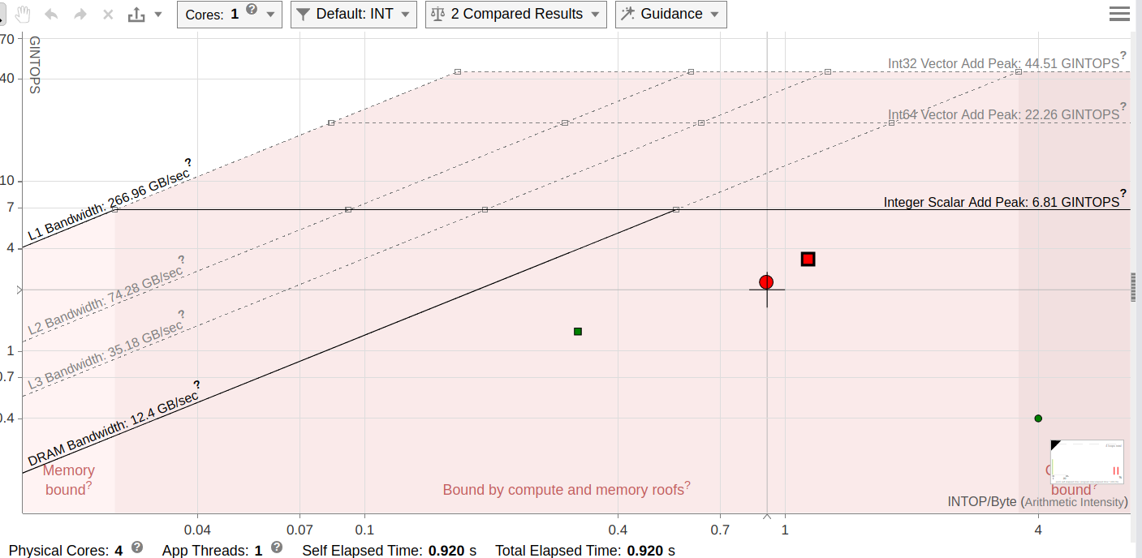
Software Optimized
Roofline Model
Red Circle represents the unoptimized version
Red square represents the optimized version
Less dependent on memory bandwidth
Better parallelism

Slide 11
Software Optimized
x86 (sec)
Ν | Μ | Unoptimized | Optimised | Optimization
32 | 32 | 0.00002 | 0.000015 | 25.0000%
32 | 65536 | 0.037108 | 0.024057 | 35.1703%
256 | 65536 | 0.303335 | 0.196926 | 35.0797%
256 | 300000 | 1.388256 | 0.897239 | 35.3693%
ARM (sec)
Ν | Μ | Unoptimized | Optimised | Optimization
32 | 32 | 0.000098 | 0.000045 | 54.0816%
32 | 65536 | 0.175177 | 0.076079 | 56.5702%
256 | 65536 | 1.402216 | 0.586488 | 58.1742%
256 | 300000 | 6.417753 | 2.685104 | 58.1613%

Slide 12
Hardware
Workflow
Optimization
C Simulation
Synthesis Design Report
QEMU Emulation
Native test & Timing

Slide 13
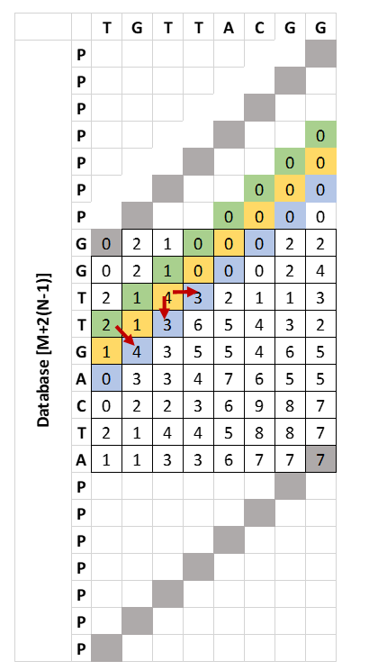
Hardware Optimizations
Algorithmic Optimizations
Diagonal Parallelism
2 Nested loops
Outer: Diagonals
Inner: Elements of diag.
Data Dependencies
Similarity Matrix doesn’t need to be outputted
Only need 2 diag. above
Double the size of current diagonal buffer to fight write-after-read during the ending-starting on iteration

Slide 14
Hardware Optimizations
HLS Optimizations
Array buffers
Block RAM or Flip-Flops
Cyclic, Block or Complete
Partition or Reshape
Arbitrary Elements
Reduce the size of buses in use
Save bandwidth
Database, Query and direction matrix are 3-bit elements
Other elements such as max_index shouldn’t be limited unless it is made sure they are kept in bounds

Slide 15
Comparison
FPGA vs x86
Ν | Μ | x86 | FPGA
32 | 32 | 0.00002 | 0.0008173
32 | 65536 | 0.037108 | 0.1757924
256 | 65536 | 0.303335 | 2.176

Slide 16


